Slide 1
Microsoft Build

Slide 2
Agentic RAG: build a reasoning retrieval engine with Azure AI Search
Matt Gotteiner, Senior Program Manager – Azure AI
Pamela Fox, Principal Cloud Advocate – Python

Slide 3
Topics
1
What is RAG
2
Introducing agentic retrieval
3
Agentic retrieval in Agent Service
4
Building agentic RAG end-to-end
5
Q&A

Slide 4
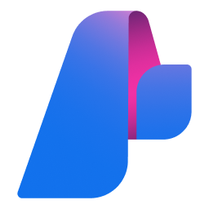
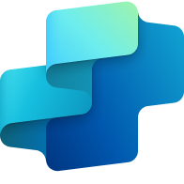

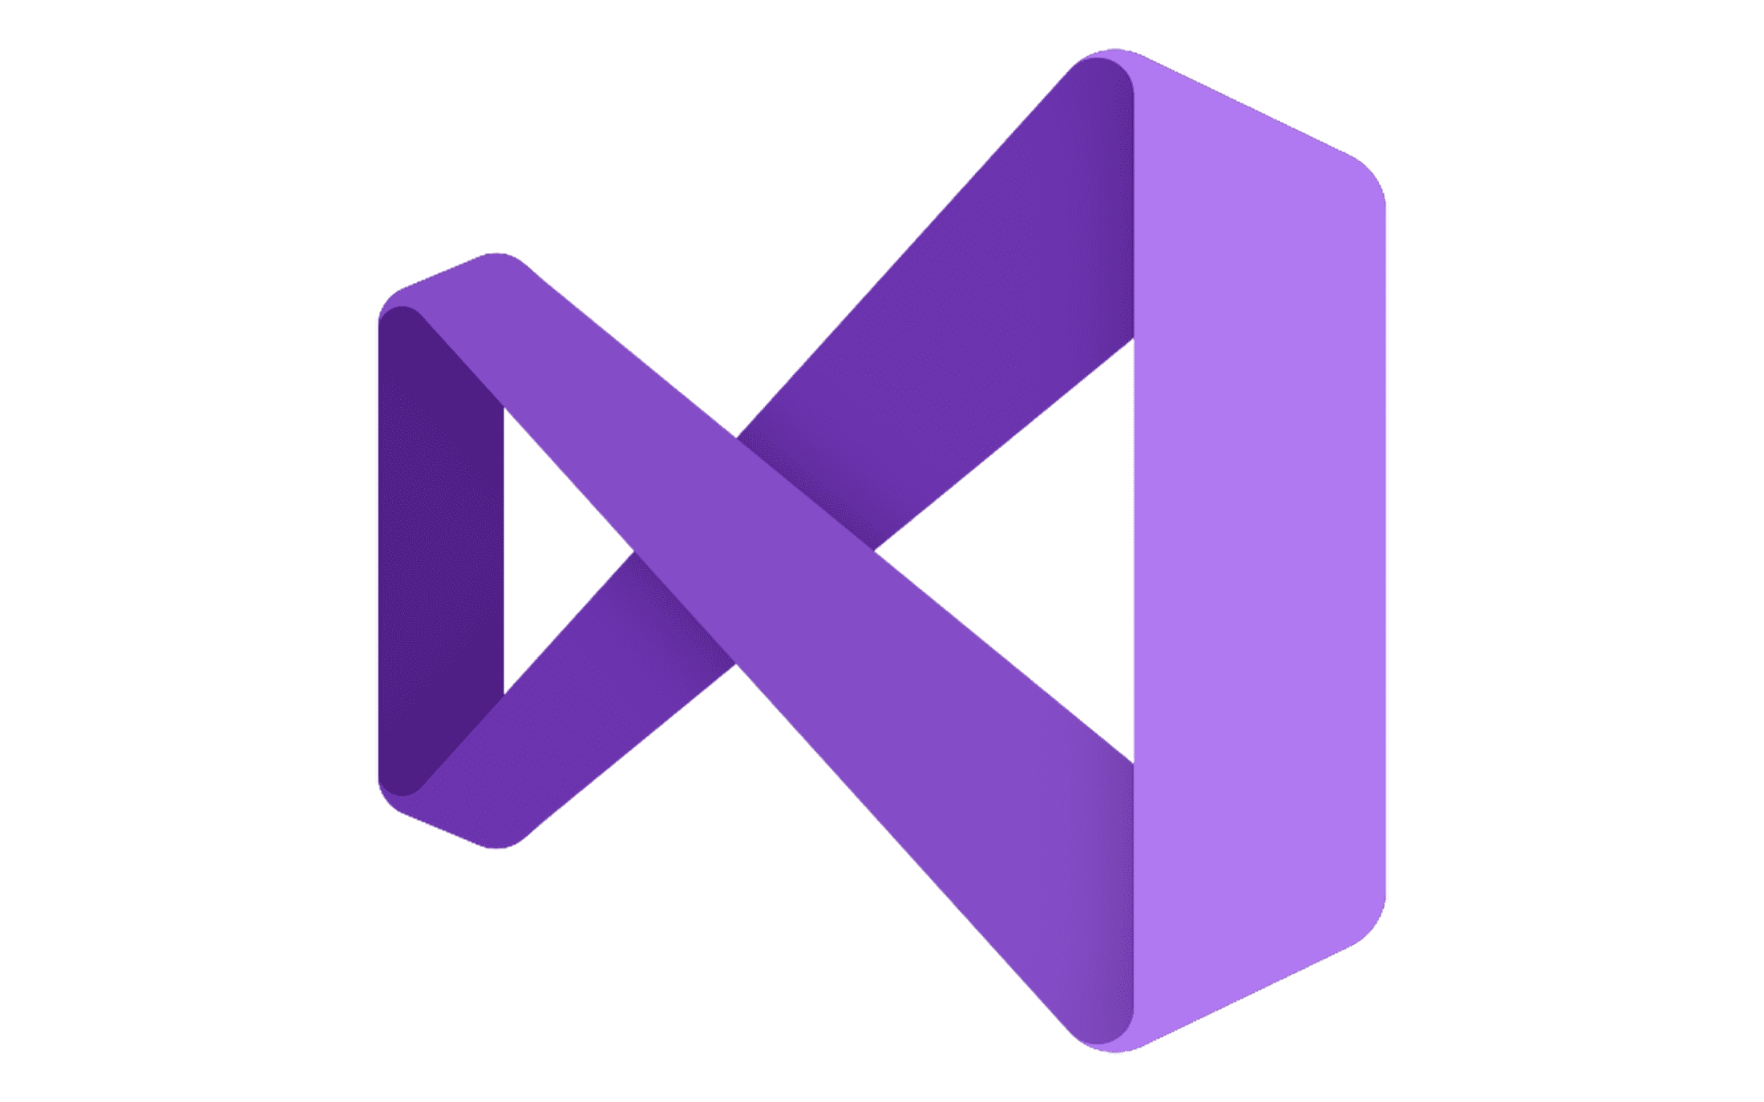







Azure AI Foundry
Copilot
Studio
Foundry Models
Cloud
Visual
Studio
Azure
Foundry Agent Service
Azure Arc
GitHub
Azure AI
Search
Azure AI
Services
Azure
Machine Learning
Azure AI
Content Safety
Foundry Local
Foundry
SDK
Foundry Observability
Edge
Security • Identity • Management
Control
Azure Kubernetes Service
Azure App Service
Azure Container Apps
Azure Functions
Serverless

Slide 5






















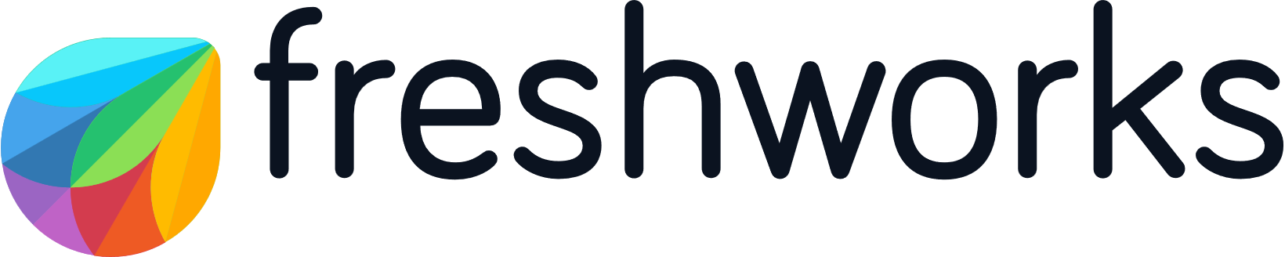










































70,000+ organizations using Azure AI Foundry today

Slide 6
Introduction to RAG

Slide 7
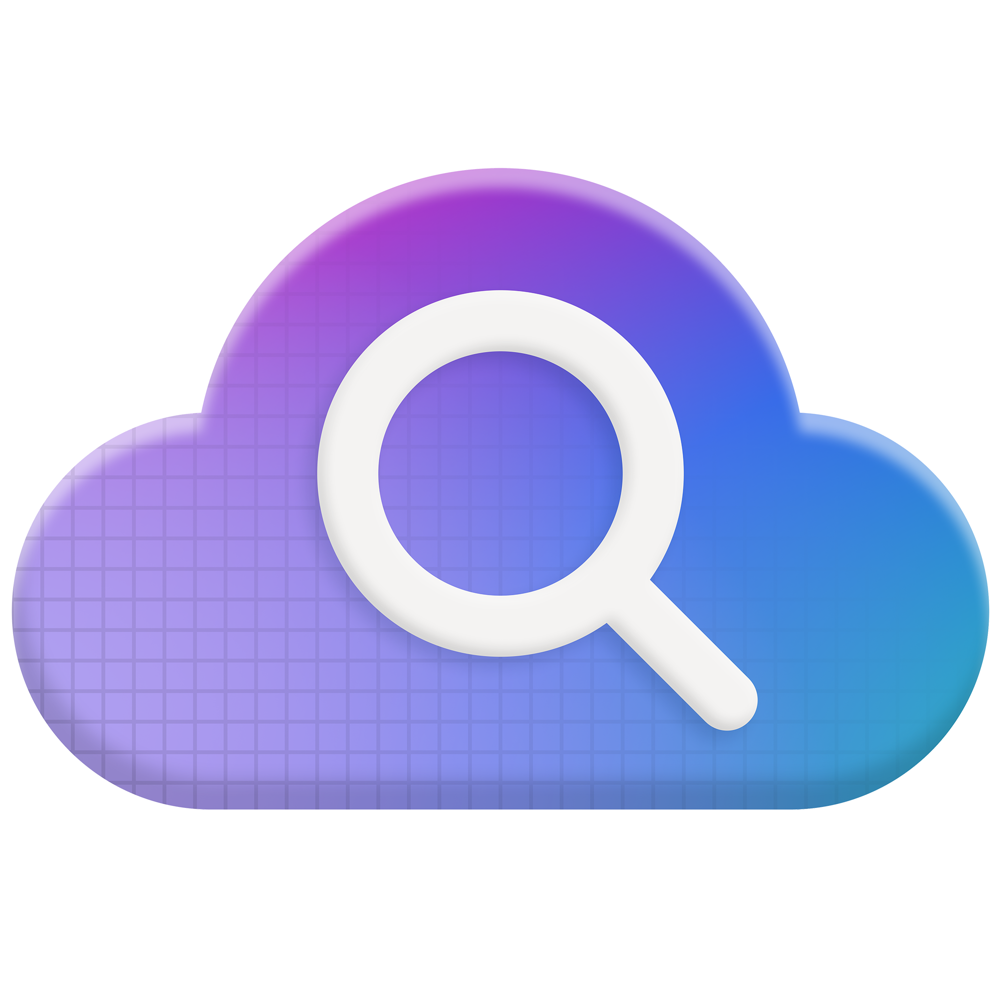
Announcement slide with secondary announcements (dark)
Azure AI Search
  State-of-the-art RAG
Rigorously tested
retrieval
Streamlined data pipeline
Developer
integrations
Enterprise-ready
foundation

Slide 8
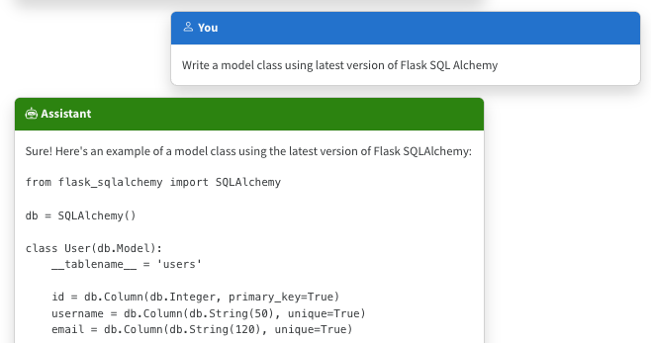
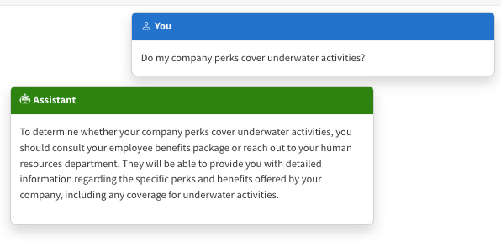
The limitations of LLMS
Outdated public knowledge
No internal knowledge

Slide 9
Incorporating domain knowledge
Fine
tuning
Retrieval
augmentation
Learn new skills
(permanently)
💵 High cost, time 🕰️
Learn new facts
(temporarily)

Slide 10
RAG: Retrieval Augmented Generation
Both plans offer coverage for medical services, such as doctor visits and lab tests, but the
Health Plus plan also covers hospital stays and X-rays.¹
What is included in my Northwind Health Plus plan that is not in standard?
[Benefit_Options.pdf#page=3] Both plans offer coverage for medical services. Northwind Health Plus offers coverage for hospital stays, doctor visits, lab tests, and X-rays. Northwind Standard only offers coverage for doctor visits and lab tests. …
Large Language Model
User
Question
Search

Slide 11
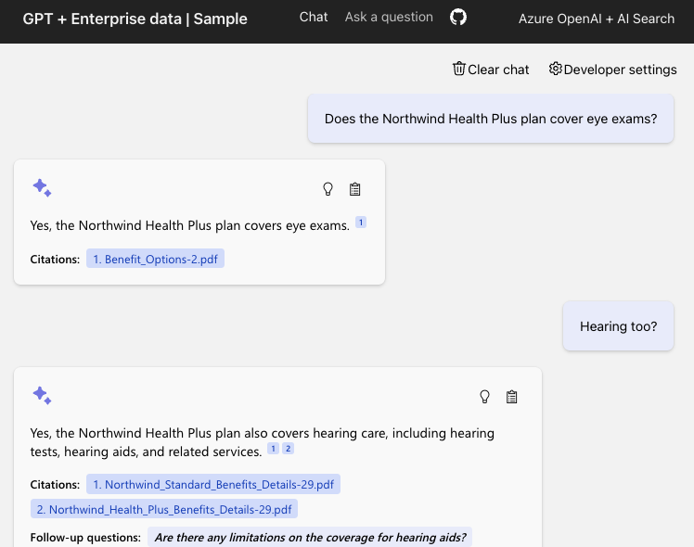
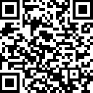
Demo: Open source RAG solution
Code:
aka.ms/ragchat
Demo:
aka.ms/ragchat/demo

Slide 12
Components of a high-quality RAG
1
2
3
Sophisticated
LLM
Well prepared
data
Powerful search functionality
Adheres to instructions
Supports function calling
Reasonably sized text
Meaningful vectors
Vector search
Hybrid search
Semantic re-ranking
Filtering

Slide 13

Azure AI Search
Comprehensive
search solution
Enterprise-ready
Integrated with Semantic Kernel, LangChain, LlamaIndex, Azure OpenAI, Azure AI Studio, and more

Slide 14
Recap: Azure AI Search Query Pipeline
Query
L0:
Query Preprocessing
Query Rewriting
Vectorization
Text analysis
L1:
Candidate Retrieval
Vector Search
Keyword Search
Fusion (RRF)
L2:
Ranking
Semantic Ranking
Results for LLM
Extractive Answers
Contextualized Captions

Slide 15
Classic search pipeline
User query
L1
L2
Query rewriting
Results as-is
from L1
Keyword search segmentation + inverted index
Reranking
e.g. cross-encoder
Vector search
embeddings + vector index
Hybrid
RRF(keyword, vector)

Slide 16
Query Rewriting
Question:
“What underwater activities can I do in the Bahamas?”
1
Water-based activities in the Bahamas
2
Water sport available in the Bahamas
3
Snorkeling and diving in the Bahamas
4
Scuba diving activities in the Bahamas
5
Underwater adventures in the Bahamas
6
Best underwater activities in the Bahamas
7
Suba diving spots in the Bahamas
8
Boating activities in the Bahamas
9
What to do in the Bahamas underwater

Slide 17
Text Search with BM25
Document ID | Hotel Name | Description
1 | Hotel Atman | Spacious rooms, ocean view, walking distance to the beach.
2 | Playa Hotel | Comfortable, air-conditioned rooms with ocean view.
Documents are stored in
an inverted index, or a sorted list of all terms
from the documents
Term | Document List
ocean | 1,2
room | 1,2
beach | 1
Queries can be efficiently matched against this index to find the original documents

Slide 18
Vector Search
Encode queries as embeddings (lists of floating point numbers)
Find semantically similar documents by comparing embeddings
Compute
embedding vector
Search
existing vectors
Query
Query vector
K closest vectors
“underwater activities”
[-0.003335318, -0.0176891904,…]
ID | Content | Cosine
1 | PerksPlus is not only designed to support employees' physical health, but also their mental health... | 0.8
2 | Some of the lessons covered under PerksPlus include: · Skiing and snowboarding lessons · Scuba diving lessons · Surfing lessons... | 0.7
🏃🏽‍♀️ Use approximate algorithm (HNSW) for more efficient search

Slide 19
Hybrid search
Vector
Keywords
Complete search stacks do better:
  Hybrid retrieval (keywords + vectors) > pure-vector or keyword
  Hybrid + Reranking > Hybrid
Fusion
(RRF)

Slide 20
Semantic Ranker
Query:
toddler-friendly
movies about cats?
A re-ranker model (cross-encoder) that reranks documents and assigns scores.
1
Winnie the Pooh
1
The Aristocats
L2
2
The Aristocats
2
Lion King
3
Lion King
3
Winnie the Pooh
Semantic ranker scores range from 0-4:
0
1
2
3
4
Worst
Quality
Best
Quality

Slide 21
A complete stack gives you optimal retrieval
Question: "What underwater activities can I do in the Bahamas?"
Keyword results
1
Scuba Diving
in Bahamas
Fusion
(RRF)
Reranking with cutoff
1
Scuba Diving in
the Carribean
1
Scuba Diving in Bahamas
Vector
results
2
Scuba Diving
in Bahamas
2
Scuba Diving in
the Carribean
1
Scuba Diving in
the Carribean
3
Water skiing
in Seychelles
2
Water skiing in Seychelles

Slide 22
However....

Slide 23
RAG can struggle with complex queries
Works
Doesn’t work
security updates KB4048959
what does ​KB4048959 fix and what systems is the patch compatibel with?
copay cost
whats the difference in costs for copays vs split pays

Slide 24
Introducing agentic retrieval in Azure AI Search

Slide 25
Agentic retrieval engine
Public preview
Azure AI Search
Contextual
retrieval
Query
planning
Parallel queries
Document references & activity log
aka.ms/agentRAG

Slide 26
Agentic retrieval engine
Public preview
Agentic methods applied to retrieval
Query planning
Fan-out query execution
Results merging
User query
Query
planning
Search query 1
L1
L2
Merged results
…
L1
L2
Conversation turns
Search query n
L1
L2
Single LLM call
Use conversation history for context • Correct spellings in context • Decompose queries as needed • Paraphrase queries

Slide 27
What is agentic retrieval in Azure AI Search?
Both plans offer coverage for medical services, such as doctor visits and lab tests, but the Health Plus plan also covers hospital stays and X-rays¹
What is included in my Northwind Health Plus plan that is not in standard?
Search
Northwind Health
Plus plan benefits
Large Language Model
Large
Language Model
Search
Standard Northwind Health plan benefits
User
Question

Slide 28
Agentic retrieval engine in Azure AI Search
What is included in my Northwind Health Plus plan that is not in standard?
Activity Log
Query | Results
Northwind Health Plus plan benefits | 3
Standard Northwind Health plan benefits | 3
Northwind
Health Plus
plan benefits
Standard Northwind Health
plan benefits
User
Question
Knowledge Agent
Search
Index
Document References
Northwind Health Plus Summary.pdf
Northwind Health Comparison.pdf
Northwind Health Standard Summary.pdf

Slide 29
Creating a knowledge agent (REST)
PUT {{url}}/agents/{{agent-name}}
{
"name": "{{agent-name}}",
"targetIndexes": [{
"indexName": "{{index-name}}",
"defaultRerankerThreshold": 2.5
}],
"models": [{
"kind": "azureOpenAI",
"azureOpenAIParameters": {
"resourceUri": …,
"deploymentId": …,
"modelName": …
}}]
}
Creates new top level agent
References existing search index
Contains connection information to your Azure OpenAI model deployment

Slide 30
Query planning in agentic retrieval
What is included in my Northwind Health Plus plan that is not in standard?
User
Question
Payroll deduction Northwind Health Plus
Northwind Health
Plus adds several types
of coverage that the Standard plan does
not have…
LLM
Reply
LLM
Query Planning
Payroll deduction Northwind Health Standard
How much more
does Northwind
Health Plus cost?
User
Question

Slide 31
Using agentic retrieval (REST)
POST {{url}}/agents/{{agent-name}}/retrieve
{
"messages": [
{ "role": "user",
"content": [
{ "type": "text", "text": "What is included in my Northwind Health Plus plan that is not in standard?" } ]
}, … ],
"targetIndexParams": {
"indexName": "{{index-name}}",
"filterAddOn": "category eq 'support'",
"rerankerThreshold":3
}
}
Accepts conversation history
Allows override of reranker threshold

Slide 32
References list: Descending rank
Document Key | Ranker Score
Northwind Health Plus Summary.pdf | 3.4
Northwind Health Comparison.pdf | 3.2
Understanding Employer Health Plans.pdf | 1.5
Document Key | Ranker Score
Northwind Health Standard Summary.pdf | 3.8
Northwind Health Comparison.pdf | 3.5
Northwind Health Plus Summary.pdf | 3.4
Search
Northwind Health Plus plan benefits
Document Key | Ranker Score
Northwind Health Standard Summary.pdf | 3.8
Northwind Health Comparison.pdf | 3.5
FAQ: Northwind Enrollment & Eligibility.pdf | 2.0
Search
Standard Northwind Health plan benefits

Slide 33
Document references from agentic retrieval (JSON)
[{
"id": 1,
"doc_key": "Northwind Health Plus Plan Benefits Summary",
"source_data": {
"chunk": "Comprehensive medical, dental, vision & Rx coverage. Low copays, $0 preventive care, generous wellness allowance…",
"sourcepage": "Northwind Health Plus Plan Benefits Summary.pdf#page=1"
}
},{
"id": 2,
"doc_key": "Comparing Northwind Health Plus and Standard Plans Benefit Highlights",
"source_data": {
"chunk": "Plus Plan: broader benefits, lower out-of-pocket. Standard Plan: essential coverage, higher deductibles…",
"sourcepage": "Comparing Northwind Health Plus and Standard Plans Benefit Highlights.pdf#page=1"
}
}, …]

Slide 34
Response string: Interleaved results
Document Key | Ranker Score
Northwind Health Plus Summary.pdf | 3.4
Northwind Health Comparison.pdf | 3.2
Understanding Employer Health Plans.pdf | 1.5
Document Key | Ranker Score
Northwind Health Plus Summary.pdf | 3.4
Northwind Health Standard Summary.pdf | 3.8
Northwind Health Comparison.pdf | 3.5
Search
Northwind Health Plus plan benefits
Document Key | Ranker Score
Northwind Health Standard Summary.pdf | 3.8
Northwind Health Comparison.pdf | 3.5
FAQ: Northwind Enrollment & Eligibility.pdf | 2.0
Search
Standard Northwind Health plan benefits

Slide 35
Activity log in agentic retrieval
LLM
Query Planning
Input Tokens: 200
Output Tokens: 50
Search
Northwind Health Plus plan benefits
Results: 3
Duration: 200ms
Search
Standard Northwind Health plan benefits
Results: 3
Duration: 250ms

Slide 36
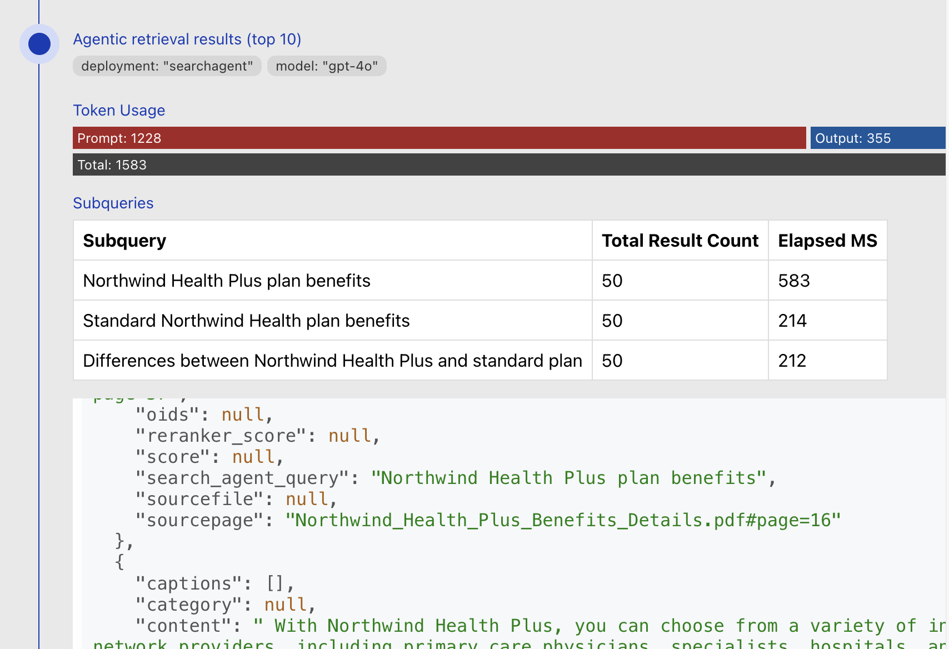
Demo: Open source RAG solution with Agentic Retrieval
Code:
aka.ms/ragchat
Docs:
aka.ms/ragchat/agentic

Slide 37
Activity log in agentic retrieval
[
{ "id": 0,
"type": "ModelQueryPlanning",
"input_tokens": 1359,
"output_tokens": 489 },
{ "id": 1,
"type": "AzureSearchQuery",
"target_index": "health_plans",
"query": { "search": "Northwind Health Plus plan benefits" },
"count": 3,
"elapsed_ms": 200 },
{ "id": 2,
"type": "AzureSearchQuery",
"target_index": "health_plans",
"query": { "search": "Standard Northwind Health plan benefits" },
"count": 3,
"elapsed_ms": 250 },
{ "id": 4,
"type": "AzureSearchSemanticRanker",
"input_tokens": 74224 }
]

Slide 38
Create a search agent (Python)
from azure.search.documents.indexes import SearchIndexClient
from azure.search.documents.indexes.models import KnowledgeAgent
index_client = SearchIndexClient(endpoint=endpoint, credential=DefaultAzureCredential())
agent = KnowledgeAgent(
name=agent_name,
models=[KnowledgeAgentAzureOpenAIModel(
azure_open_ai_parameters=
AzureOpenAIVectorizerParameters(
resource_url=azure_openai_endpoint,
deployment_name=azure_openai_deployment,
model_name=azure_openai_gpt_model))],
target_indexes=[KnowledgeAgentTargetIndex(
index_name=index_name,
default_reranker_threshold=2.5)])
index_client.create_or_update_agent(agent)

Slide 39
Using agentic retrieval (Python)
agent_client = KnowledgeAgentRetrievalClient(endpoint=endpoint, agent_name=agent_name, credential=credential)
messages.append({
"role": "user",
"content": "What is included in my Northwind Health Plus plan that is not in standard?"
})
retrieval_result = agent_client.knowledge_retrieval.retrieve(
retrieval_request=KnowledgeAgentRetrievalRequest(
messages=[KnowledgeAgentMessage(role=msg["role"],
content=[KnowledgeAgentMessageTextContent(text=msg["content"])])
for msg in messages if msg["role"] != "system"],
target_index_params=[KnowledgeAgentIndexParams(index_name=index_name, reranker_threshold=2.5)]
)
)
messages.append({
"role": "assistant",
"content": retrieval_result.response[0].content[0].text
})

Slide 40
Using agentic retrieval (C#)
using Azure.Search.Documents.Agents;
var agentClient = new KnowledgeAgentRetrievalClient(
endpoint: new Uri(endpoint),
agentName: agentName,
tokenCredential: new DefaultAzureCredential());
var retrievalResult = await agentClient.RetrieveAsync(
retrievalRequest: new KnowledgeAgentRetrievalRequest(
messages: messages
.Where(message => message["role"] != "system")
.Select(
message => new KnowledgeAgentMessage(
role: message["role"],
content: new[] { new KnowledgeAgentMessageTextContent(message["content"]) }))
.ToList())
{ TargetIndexParams = { new KnowledgeAgentIndexParams {
IndexName = indexName, RerankerThreshold = 2.5f } } });
messages.Add(new Dictionary<string, string>
{
{ "role", "assistant" },
{ "content", (retrievalResult.Value.Response[0].Content[0] as KnowledgeAgentMessageTextContent).Text }
});

Slide 41
Create a search agent (C#)
using Azure.Search.Documents.Indexes;
var indexClient = new SearchIndexClient(new Uri(endpoint), new DefaultAzureCredential());
var agentModel = new KnowledgeAgentAzureOpenAIModel(azureOpenAIParameters: openAiParameters);
var targetIndex = new KnowledgeAgentTargetIndex(indexName) { DefaultRerankerThreshold = 2.5f };
var agent = new KnowledgeAgent(
name: agentName,
models: new[] { agentModel },
targetIndexes: new[] { targetIndex });
await indexClient.CreateOrUpdateKnowledgeAgentAsync(agent);

Slide 42
Agentic retrieval in Azure AI Foundry Agent Service

Slide 43
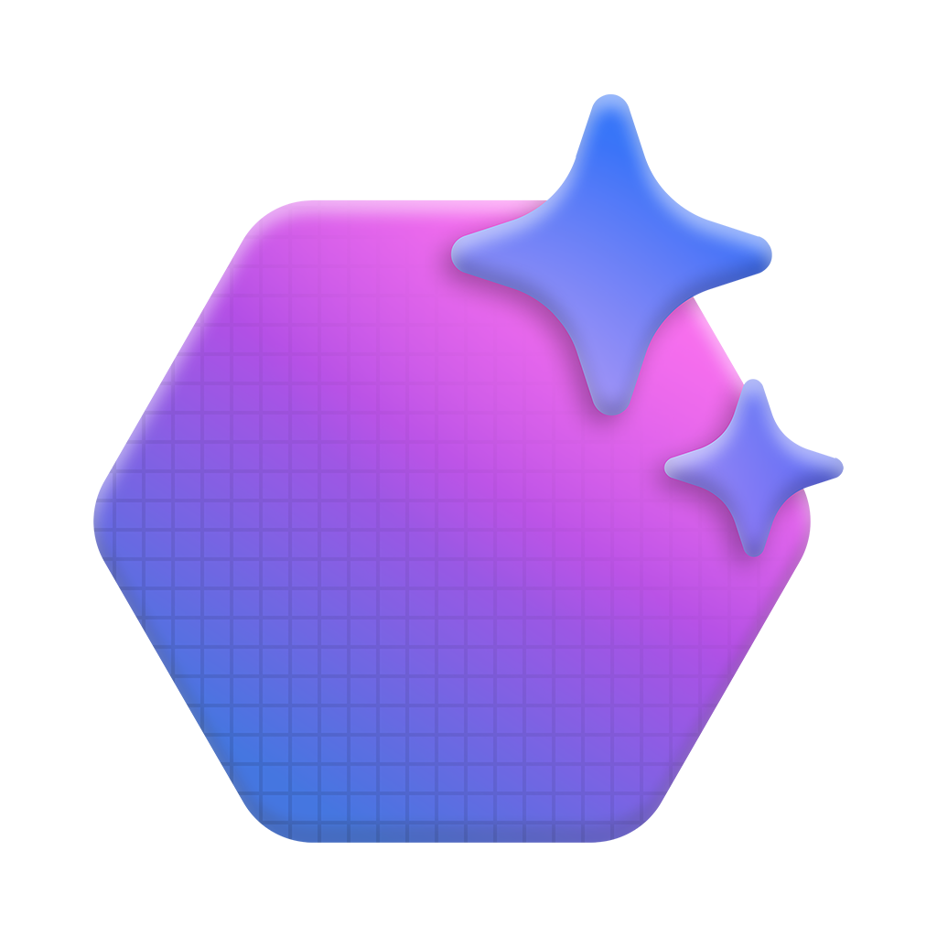

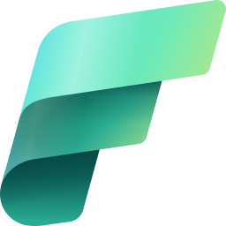
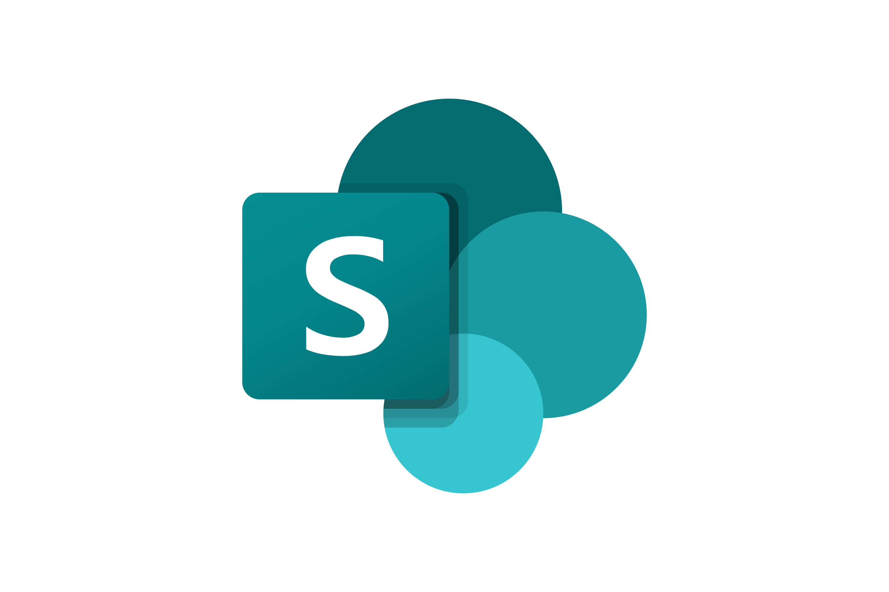


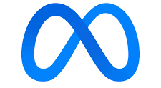







Azure AI Foundry Agent Service
Securely design, deploy, and scale AI agents with ease
Tools
Choice
Trust
Richest set of
enterprise connectivity
Model choice and flexibility with
the model catalog
Customer control over data, networking, and security
Azure OpenAI Service
o3-mini, o1, GPT-4o, GPT-4o mini
Knowledge
BYO-file storage
BYO-search index
BYO-virtual network
BYO-thread storage
Tracing/monitoring
Evaluation
Models-as-a-Service
Actions
Llama 3.1-405B-Instruct
Mistral Large, Small
Cohere-Command
Logic
Apps
Azure Functions
Open
API
MCP
DeepSeek v3
Azure AI Foundry SDK/Portal, VS Code Extension

Slide 44

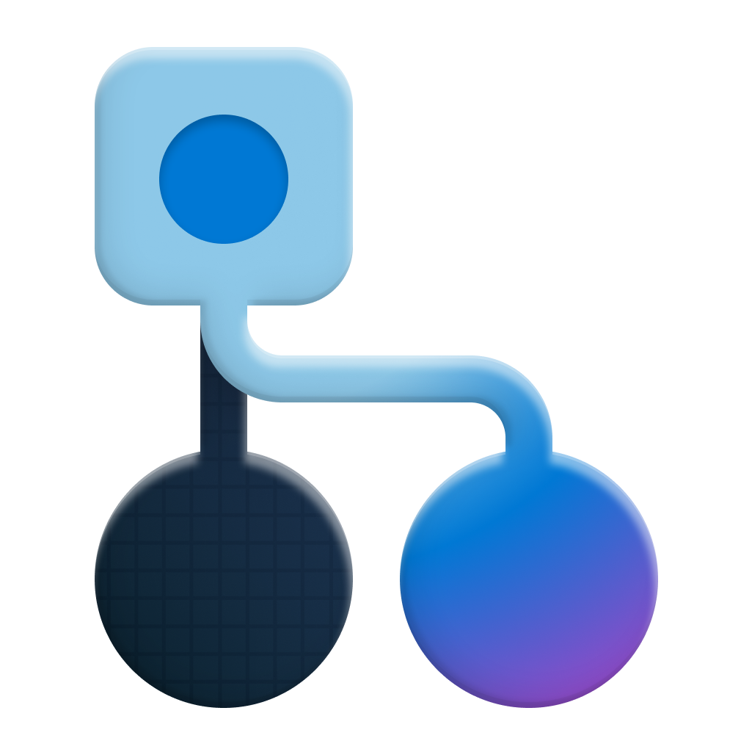

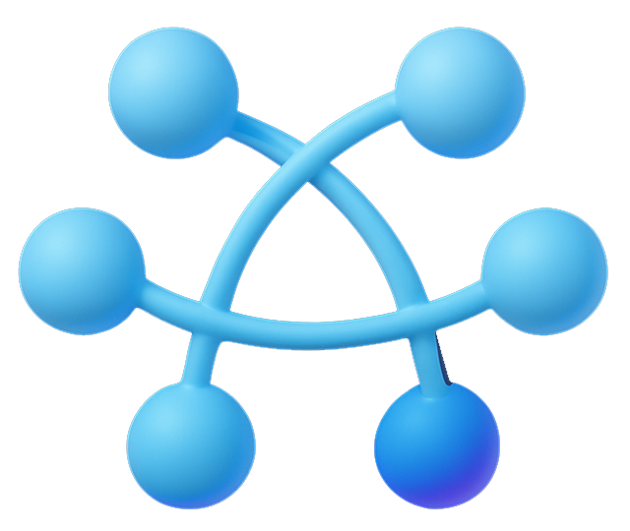
Agentic retrieval and Azure AI Foundry Agent Service
Agentic
Retrieval Tool
Search Service
Knowledge
Agent
Search
Index
Conversation history
Agent
Agent
response

Slide 45
Create an Agent (Python)
from azure.ai.projects import AIProjectClient
project_client = AIProjectClient.from_connection_string(
project_conn_str, credential=DefaultAzureCredential())
agent = project_client.agents.create_agent(
model=agent_model,
name=agent_name,
instructions="You are a helpful agent"
)
Creates an agent on
the foundry project

Slide 46
Setup the agentic retrieval tool (Python)
from azure.search.documents.agent import KnowledgeAgentRetrievalClient
agent_client = KnowledgeAgentRetrievalClient(
endpoint=endpoint, agent_name=agent_name, credential=credential)
thread = project_client.agents.create_thread()
def agentic_retrieval() -> str:
""" Use agentic retrieval to get the answer """
# Take 5 messages from the thread
messages = project_client.agents.list_messages(thread.id, limit=5)
request = KnowledgeAgentRetrievalRequest(
messages=[KnowledgeAgentMessage(role=msg["role"],
content=[KnowledgeAgentMessageTextContent(
text=msg.content[0].text)])
for msg in messages.data])
result = agent_client.knowledge_retrieval.retrieve(request)
return result.response[0].content[0].text
toolset = ToolSet()
toolset.add(FunctionTool({ agentic_retrieval }))
project_client.agents.enable_auto_function_calls(toolset=toolset)
Use function calling
to use agentic retrieval
Use messages from the current thread as conversation history

Slide 47
Agentic retrieval with Azure AI Foundry Agent Service

Slide 48
Evaluation

Slide 49
Agentic Retrieval Evals
+40%
+30%
RAG answer relevance
RAG answer
result rate
(For complex queries requiring information from multiple documents)
Agentic Retrieval
Full evals results and methodology description: aka.ms/aisearch-arevals

Slide 50
Query planning performance
Different query planning models generate different amounts of subqueries

Slide 51
Use Case
RAG chatbot
“Using Azure AI Search for our RAG chatbot has significantly
improved our customer support experience.
By delivering faster website searches and answers across service pricing, conditions, appointment booking and how-to procedures, we have reduced waiting queues and service times by 45% in the past five months.
This improvement has led to faster response times and a notable
increase in our NPS score.”
Andrés Gómez
Sr. Data Scientist & Founder
ADGG Solutions

Slide 52
Supported models
gpt-4o
gpt-4o-mini
gpt-4.1
gpt-4.1-mini
gpt-4.1-nano

Slide 53
Conclusion

Slide 54
Resources and next steps
Get Started with Azure AI Search
aka.ms/AISearch-new
Agentic retrieval free in first phase of public preview
aka.ms/AgentRAG
GitHub Sample – Quickstart
aka.ms/AISearch-ar-pyn
GitHub Sample – Agent Service Integration
aka.ms/AISearch-ar-agent
Take the Azure AI Learn Courses
aka.ms/CreateAgenticAISolutions

Slide 55
Thank you!
a
Session code
Title
Date/time
Recorded
  BRK141
Knowledge Retrieval: RAG for enterprise agents with Azure AI Search
May 19
6:00 PM
We appreciate your time with us
Stop by the Expert Meet-up
to get your questions answered
Your feedback is important!
Visit aka.ms/MicrosoftBuildEvals
to complete your session evaluations
  BRK142
Agentic RAG: build a reasoning retrieval engine with Azure AI Search
May 21 12:30 pm
  DEM529
Agentic RAG using memory
May 19
2:25 pm
  LAB335
Build Your First Agentic RAG Solution with Azure AI Search
May 20th
9:00, 4:30
  Expert Meetup
Azure AI Search and agentic retrieval
Throughout event

Slide 56
Q&A

Slide 57
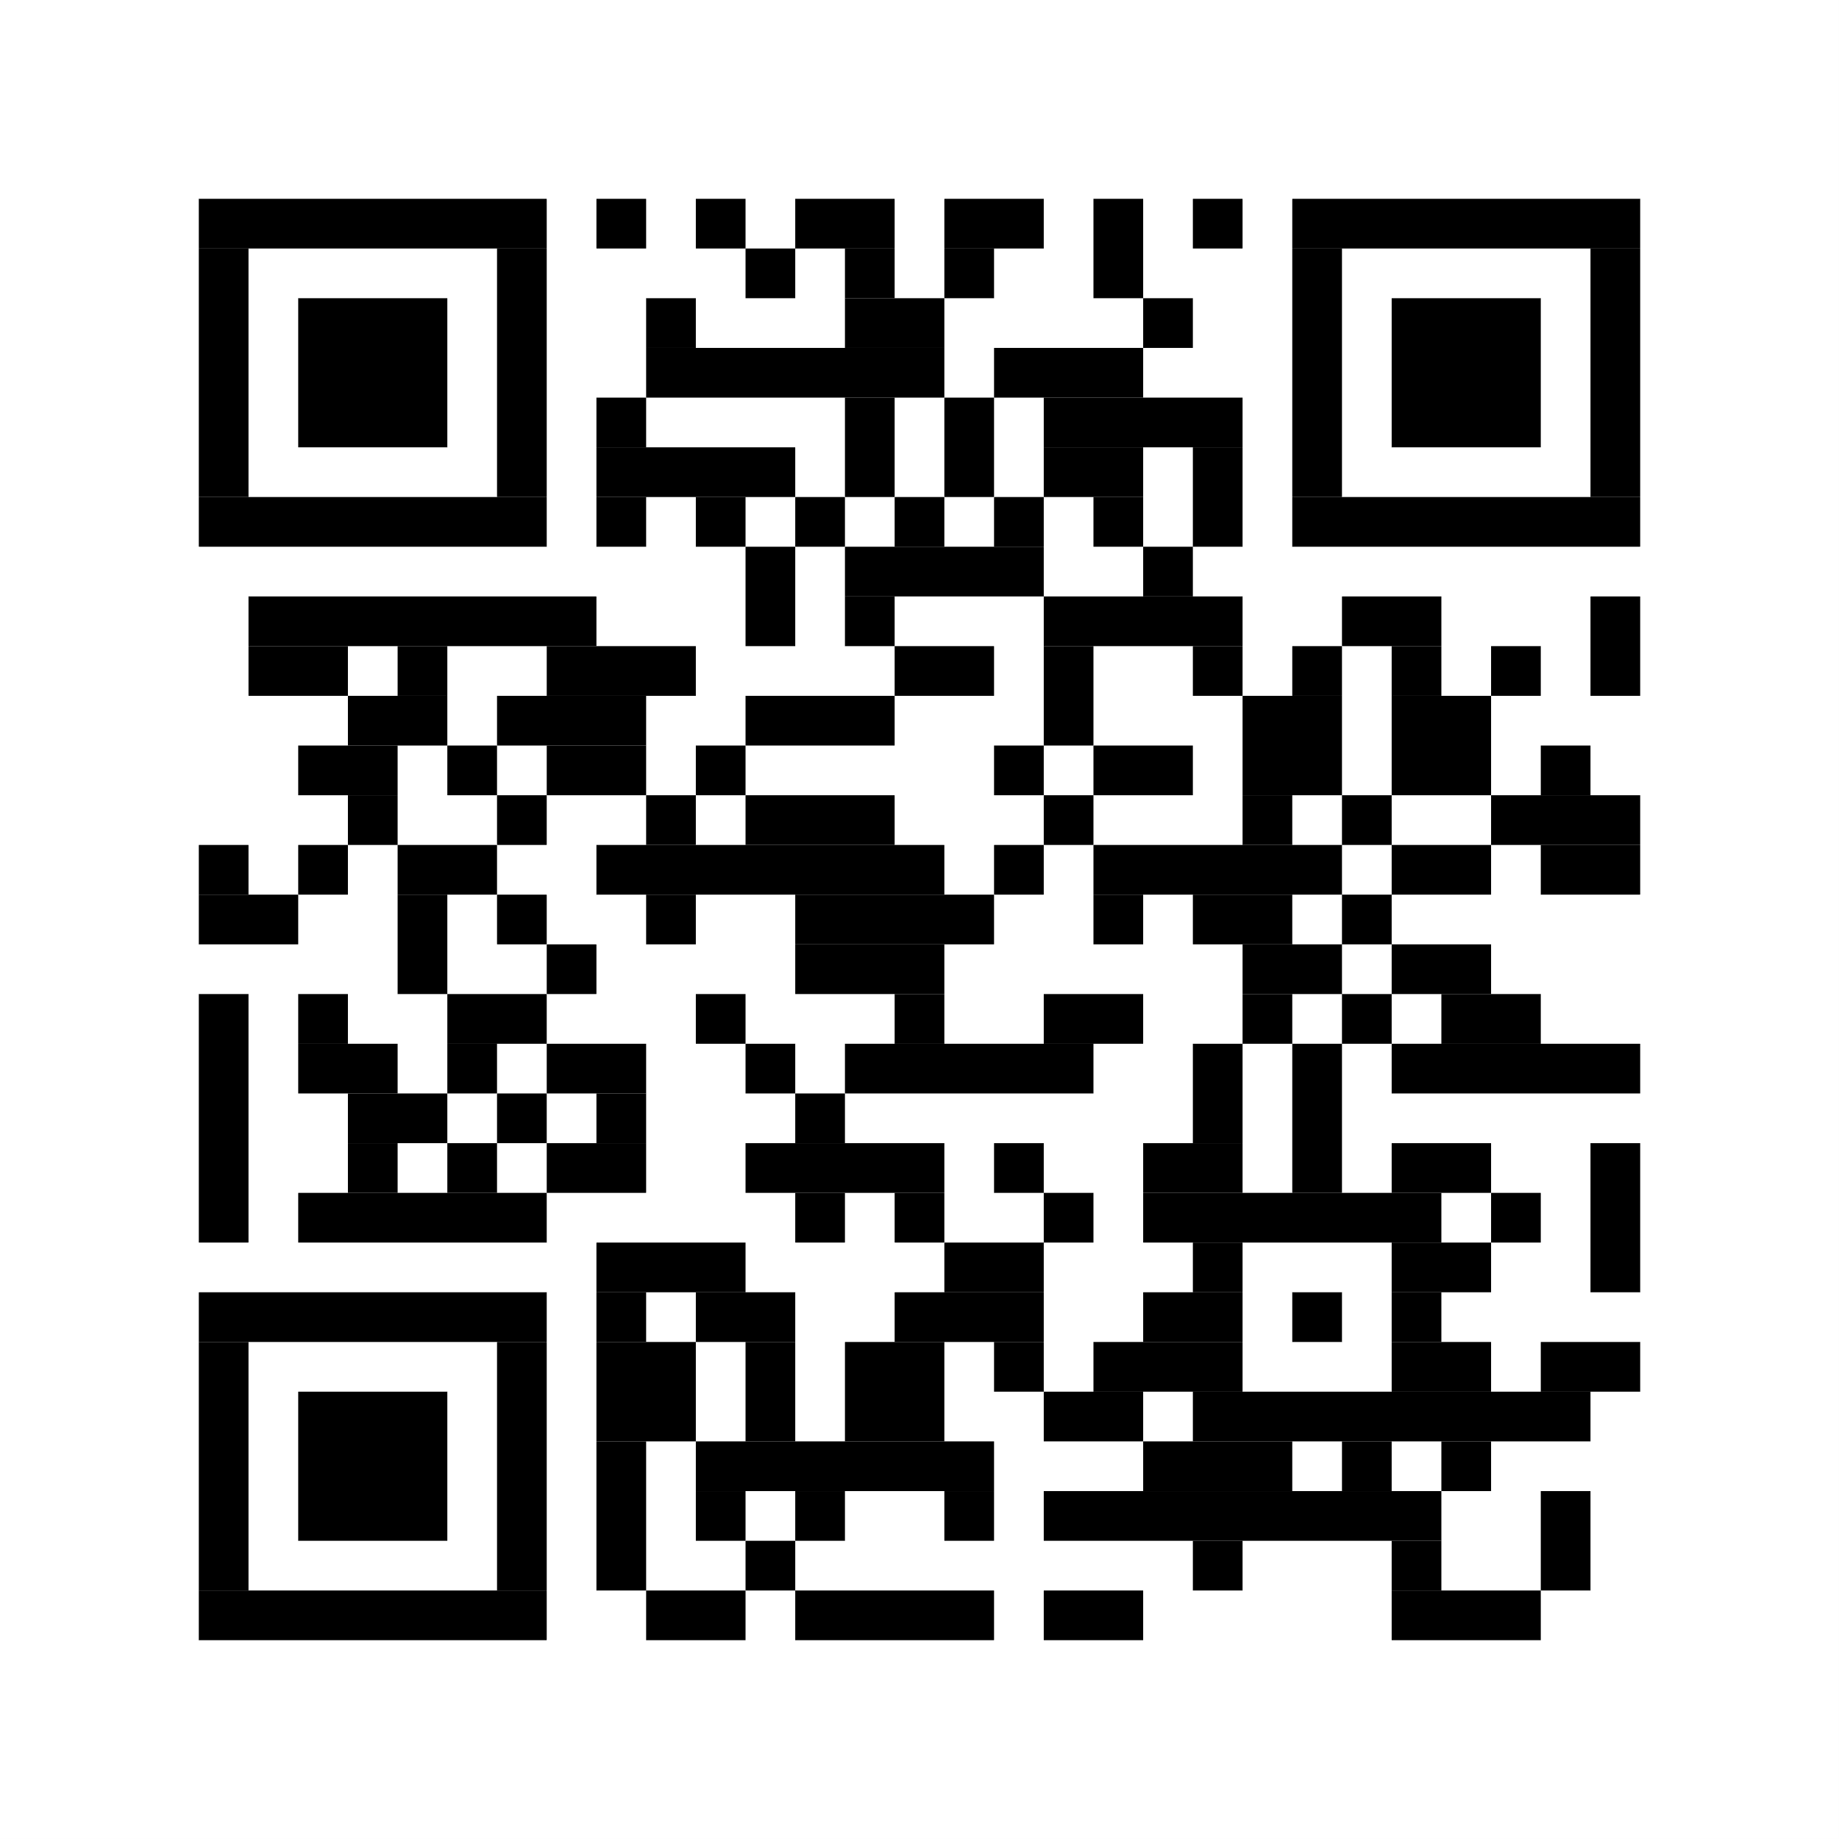
Dive into the recommended next steps on the session page to take action with tutorials, resources, and code
Scan the QR code to access the session details page and fill out a session survey
BRK142 session page

Slide 58
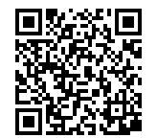


Session Resources
Next steps
Resources
Related sessions
Find all of this and more on the session details page
BRK142 session page

Slide 59
Learn more
Related sessions
  <Resource name>
    <resource AKA link>
  <Resource name>
    <resource AKA link>
  <Resource name>
    <resource AKA link>
  <Resource name>
    <resource AKA link>
  BRK192 • Maximize joy, minimize toil with great developer experiences​
    May 21 1:00-1:45 PM Pacific On demand
  <session code> • <session title>
    <Day and time> <location>
  <session code> • <session title>
    <Day and time> <location>
  <session code> • <session title>
    <Day and time> <location>
  <session code> • <session title>
    <Day and time> <location>

Slide 60
Resources and next steps
Option 1
Get Started with Azure AI Search
aka.ms/AISearch-new
Agentic retrieval free in first phase of public preview
aka.ms/AgentRAG
GitHub Samples
aka.ms/tbd
Take the Azure AI Learn Courses
aka.ms/CreateAgenticAISolutions

Slide 61



Call to Action
Resources
Learn
Try
Blog | Agentic retrieval announcement | aka.ms/agentrag
Blog | Agentic retrieval eval results | aka.ms/aisearch-arevals
Blog | Multimodal updates | aka.ms/aisearch-multim
Docs | What’s new in Azure AI Search | aka.ms/AISearch-new
Signup form | Private preview, sensitivity labels | aka.ms/AISearch-senslabels
Github repo | Agentic retrieval demo | aka.ms/ragchat
Github repo | Multimodal demo | aka.ms/aisearch-multimodal
Github repo | Azure MCP repo | aka.ms/azure-mcp
Github repo | Foundry MCP server | aka.ms/foundry-mcp

